Slide 1
Linear Maps
Coordinate Definition (arrays)
Geometric Definition (pictures)
Abstract Definition (algebra)
Notes:
So we’ve finished up our discussion of covectors. In this video we’re going to be talking about our third example of a tensor, which are linear maps. Linear maps are transformations that take a vector as an input and product some new vector as an output.
So in a sense, linear maps move vectors… so you might be wondering, I’ve made this huge deal about how vectors are invariant and how they don’t change.
So I don’t mean that vector don’t change, we can move them around and stuff if we want, what I mean is vectors are invariant, under a coordinate system change. So they are invariant when we change coordinate system, but they can still change in other ways
So just like vectors and covectors, linear maps have a coordinate interpretation that is an array of numbers where the numbers vary depending on the basis. And even though that isn’t the best definition we can offer, it’s a good place to start.

Slide 2
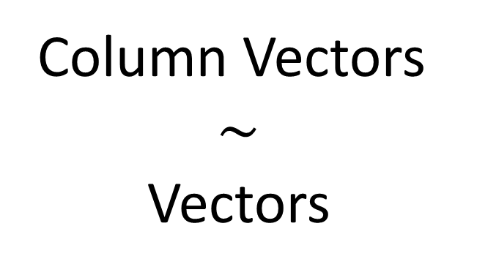

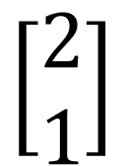
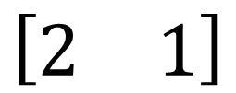
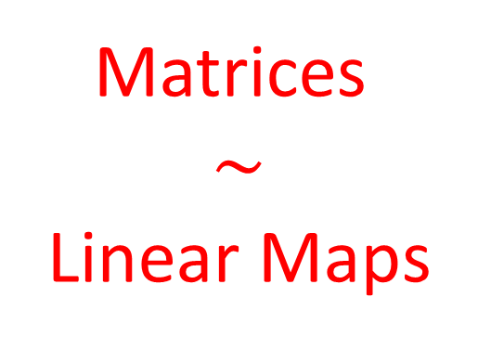
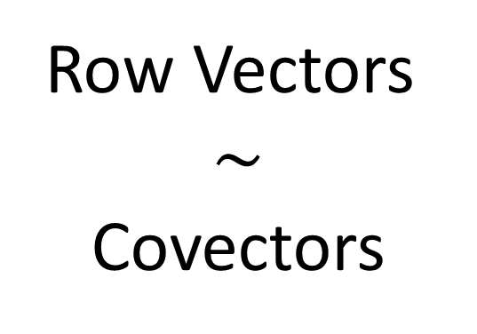
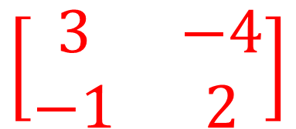
Matrices are the coordinate version of linear maps
$$\left[\begin{matrix}\text{3} & −4 \\ −1 & 2\end{matrix}\right]$$
$$\left[\begin{matrix}2 \\ 1\end{matrix}\right]$$
$$\left[\begin{matrix}2 & 1\end{matrix}\right]$$
Matrices
$$\sim$$
Linear Maps
Column Vectors
$$\sim$$
Vectors
Row Vectors
$$\sim$$
Covectors
Notes:
So MATICES end up being the coordinate representation of linear maps. A matrix being a 2-dimensional array of numbers.
So Just as column vectors are the coordinate representation of vectors and row vectors are the coordinate representation of covectors, matrices are the coordinate representation of linear maps.
So when we ask how linear maps transform vectors…
When we’re dealing with coordinates, the corresponding question is, how do matrices transform column vectors?
So let’s take a look at that.

Slide 3

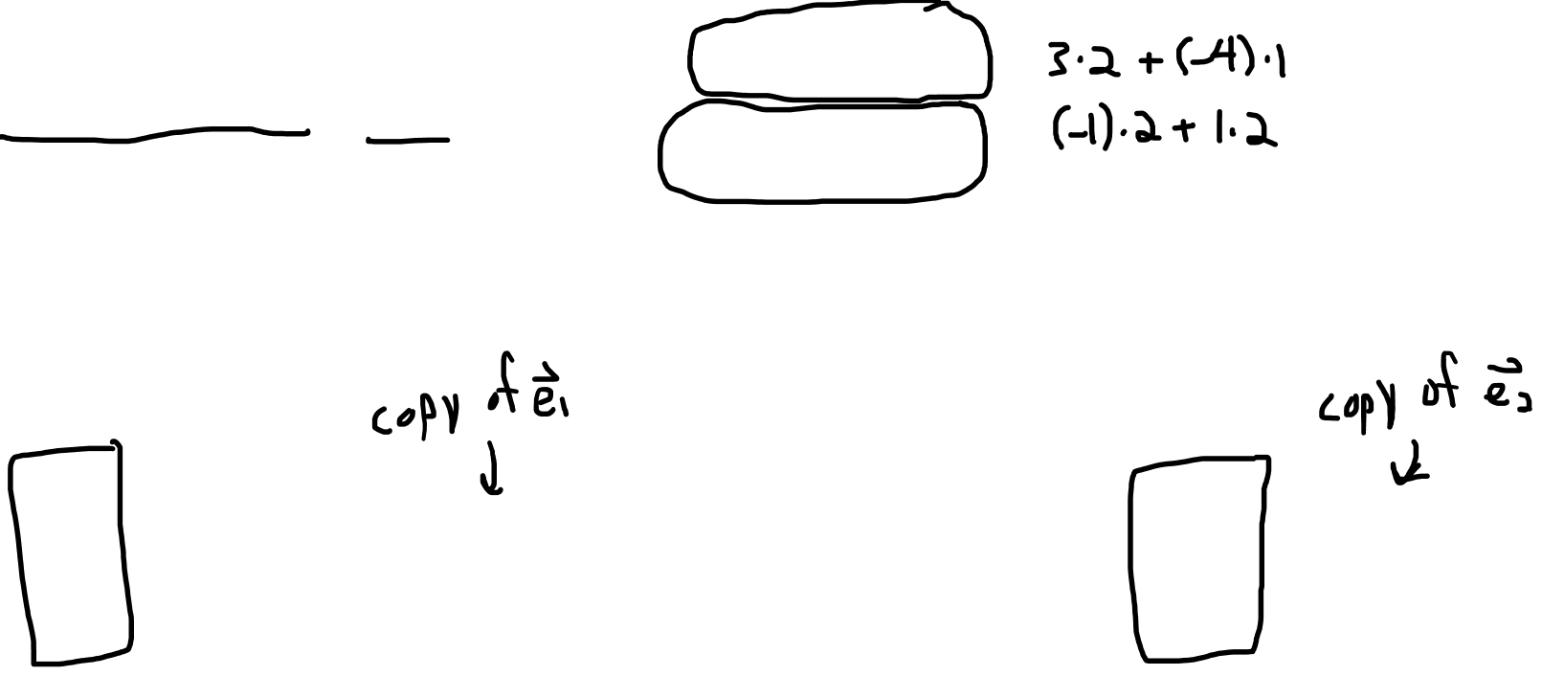
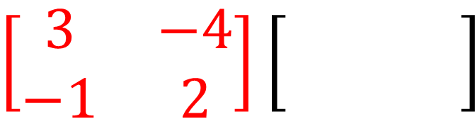
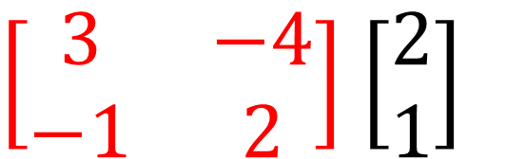
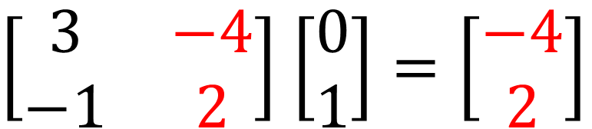
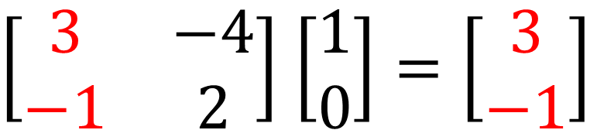

Matrices transform column vectors…
$$\left[\begin{matrix}2 \\ 1\end{matrix}\right]$$
$\left[\begin{matrix}\text{3} & −4 \\ −1 & 2\end{matrix}\right]$ $\left[\begin{matrix}2 \\ 1\end{matrix}\right]$
$$\left[\begin{matrix}\text{3} & −4 \\ −1 & 2\end{matrix}\right]\left[\begin{matrix} − \\ −\end{matrix}\right]$$
$$=\left[\begin{matrix}2 \\ 0\end{matrix}\right]$$
$\left[\begin{matrix}\text{3} & −4 \\ −1 & 2\end{matrix}\right]$ $\left[\begin{matrix}1 \\ 0\end{matrix}\right]=\left[\begin{matrix}3 \\ −1\end{matrix}\right]$
$\left[\begin{matrix}\text{3} & −4 \\ −1 & 2\end{matrix}\right]$ $\left[\begin{matrix}0 \\ 1\end{matrix}\right]=\left[\begin{matrix}−4 \\ 2\end{matrix}\right]$
Notes:
Here we have a 2x2 matrix acting on a 2x1 column vector.
And the way we determine what the output vector is here, we use the standard matrix multiplication rules.
So what that means is, first we take the dot product of the column vector with the first row of the matrix… (…….)
And then we take the dot product of the column vector and the second row of the matrix… (……)
And so the output ends up being the column vector [2,0]
Now these numbers in the matrix, what are they actually doing? What do all these numbers actually mean.
Well, you’ll notice that if I use the column vector [1,0] as the input, and that’s just a vector that’s lying on top of the first basis vector, same length, and direction… If I do this I’ll get the first column of the matrix as the output.
And if I put in the column vector [0,1] as the input, which is just a vector lying on top of the second basis vector, I get the second matrix column as the output.
So essentially with matrices, the Nth column tells you where to map a copy of the nth basis vector.
So let’s take a look at that visually.

Slide 4
Linear Maps transform input vectors
Linear Maps don’t transform the basis.
Notes:
So we’ve finished up our discussion of covectors. In this video we’re going to be talking about our third example of a tensor, which are linear maps. Linear maps are transformations that take a vector as an input and product some new vector as an output.
So in a sense, linear maps move vectors… so you might be wondering, I’ve made this huge deal about how vectors are invariant and how they don’t change.
So I don’t mean that vector don’t change, we can move them around and stuff if we want, what I mean is vectors are invariant, under a coordinate system change. So they are invariant when we change coordinate system, but they can still change in other ways
So just like vectors and covectors, linear maps have a coordinate interpretation that is an array of numbers where the numbers vary depending on the basis. And even though that isn’t the best definition we can offer, it’s a good place to start.

Slide 5


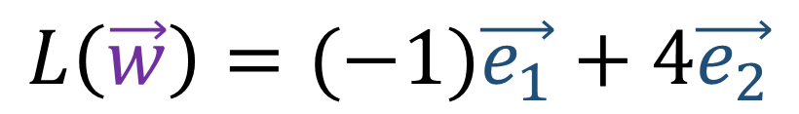


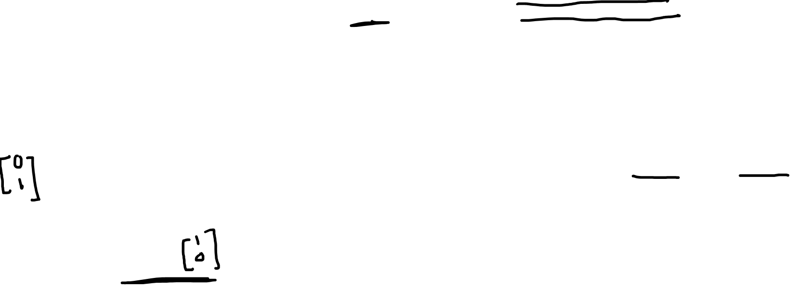
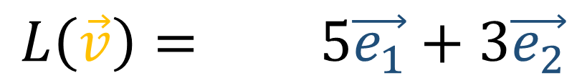


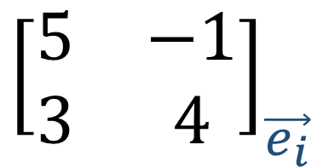

$$L\left(\vec{w}\right)$$
$${\left[\begin{matrix}5 & −1 \\ 3 & 4\end{matrix}\right]}_{\vec{e_{i}}}$$
$$L\left(\vec{v}\right)$$
$$\vec{e_{2}}$$
$$L\left(\vec{v}\right)= 5\vec{e_{1}}+3\vec{e_{2}}$$
$$\vec{w}$$
$$\vec{e_{1}}$$
$$L\left(\vec{w}\right)=(−1)\vec{e_{1}}+4\vec{e_{2}}$$
$$\vec{v}$$
Notes:
So here we have a basis e1, e2, and vectors v and t, which are sort of line copies of e1 and e2, and a matrix with first column [5,3] and second column [-1,4]
So where would this matrix send vector v, which we can think of as a copy of the first basis vector? We’ll we just get back the first column, which represents the vector 5e1 + 3e2. And that’s what that looks like.
And where does this matrix send t, which we can think of as a copy the second basis vector? Well that’s just the second matrix column, which gives (-1)e1 + 4e2. And that looks like that.
Now I want to be clear that this matrix isn’t being viewed as a coordinate system change. And the reason for that is that we aren’t changing the basis… still measuring the vectors using the same basis, before AND after the transformation.
Now it’s possible, in another context that this matrix COULD be used as a forward or a backward transform to change coordinates… but in this context we’re not thinking of it like that… we’re thinking of it as actually moving vectors… just building some new basis out of an old basis.
So whether or not a matrix is being used as a linear map to move vectors around, or it’s being used to represent coordinate system changes depends on the CONTEXT. So we need to pay attention to context.

Slide 6


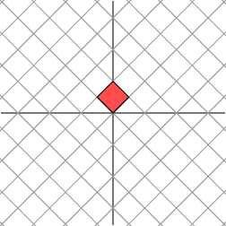
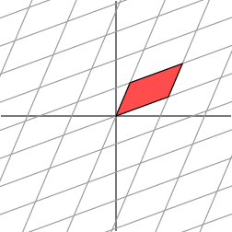

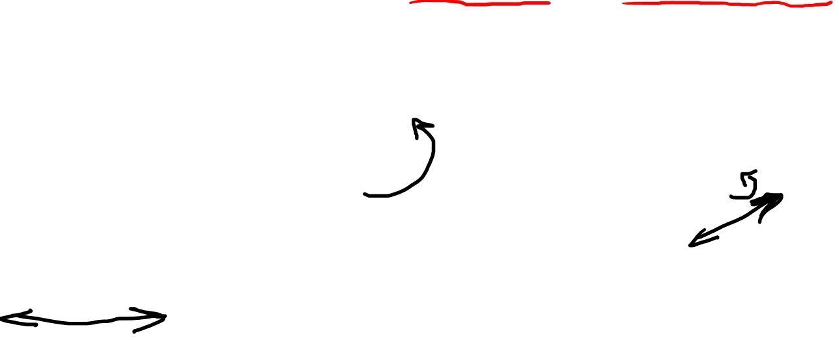
Linear Maps (geometrically) are spatial transforms that…
Keep gridlines parallel
Keep gridlines evenly spaced
Keep the origin stationary
(translations are not linear maps!)
(Images taken from the American Math Society.)
Notes:
Okay so that’s the coordinate interpretation of linear maps… let’s try to get a geometrical definition.
So linear maps are spatial transform that keep lines parallel, keep lines evenly-spaced, and keep the origin stationary.
To get an idea of that that looks like visually. Let’s start with a 2D space which has a bunch of gridlines overlayed, and this square where, which is a square which side lengths of 1, has been highlighted in red.
So let’s take a look at what some linear maps would do these gridlines.
So this linear map does some stretching in the horizontal direction. And has we can see, all the gridlines are still parallel and evenly-spaced, and the origin hasn’t moved
In this one we’ve done a rotation. So again, with rotations, the gridlines are still parallel and evenly-paced, and the origin is fixed
And here we’ve done some skewing, which you could maybe thing of as a rotation in this direction, and then a stretching along this axis
So these are examples of the types of things that linear maps can do… and I’ll just mention that translations are not actually linear maps under this definition. Even though they keep the gridlines parallel and evenly-spaced, translations do move the origin.
Okay so that’s a geometric definition that we can visualize

Slide 7
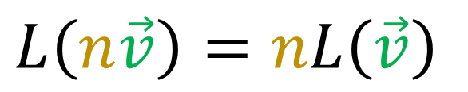
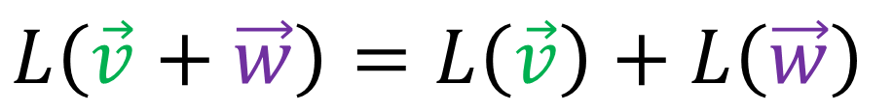
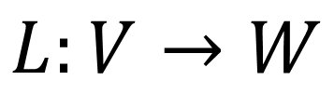
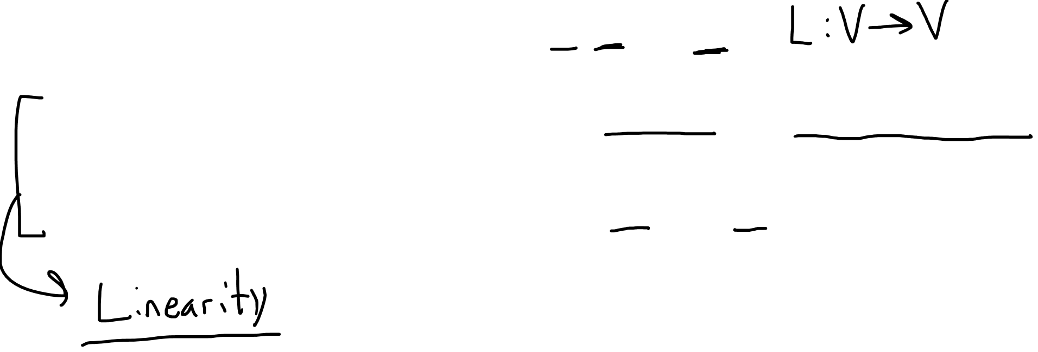
Linear Maps (abstractly)…
Maps vectors to vectors
Add inputs or the outputs
Scale the inputs or outputs
$$L:V→W$$
$$L\left(\vec{v}+\vec{w}\right)=L\left(\vec{v}\right)+L\left(\vec{w}\right)$$
$$L\left(n\vec{v}\right)=nL\left(\vec{v}\right)$$

Slide 8
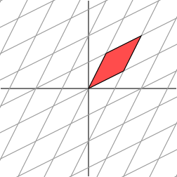
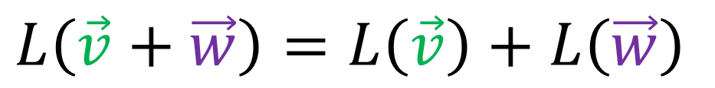
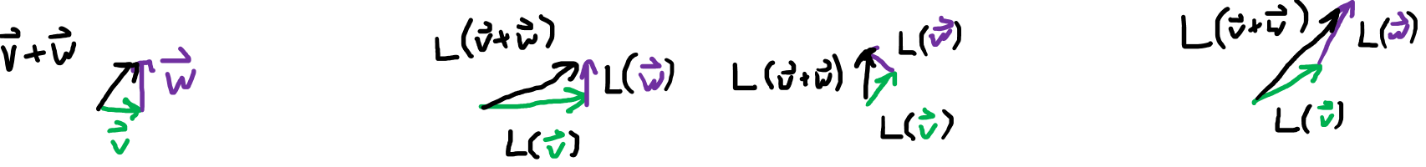
$$L\left(\vec{v}+\vec{w}\right)=L\left(\vec{v}\right)+L\left(\vec{w}\right)$$
(Images taken from the American Math Society.)
Notes:
So to try and give you a sense of what this abstract property means, what it means to be able to add inputs or add outputs and get the same answer, let’s look at some visualizations….
So we’re going to pay attention to three vectors… this green vector v… this purple vector w… and this black vector v+w…. and we’re going to see how these three vectors behave under linear maps…

Slide 9
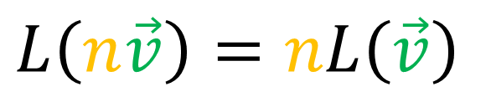
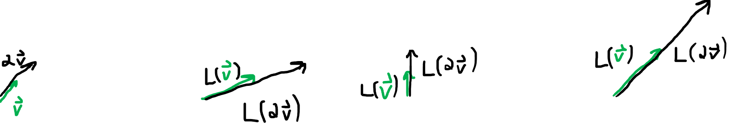
$$L\left(n\vec{v}\right)=nL\left(\vec{v}\right)$$
(Images taken from the American Math Society.)

Slide 10

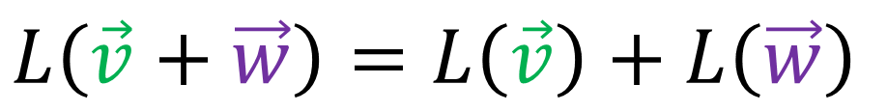


$$\left[\begin{matrix}a & b \\ c & d\end{matrix}\right]\left[\begin{matrix}x \\ y\end{matrix}\right]=\left[\begin{matrix}ax+by \\ cx+dy\end{matrix}\right]$$
$$L:V→W$$
$$L\left(\vec{v}+\vec{w}\right)=L\left(\vec{v}\right)+L\left(\vec{w}\right)$$
$$L\left(n\vec{v}\right)=nL\left(\vec{v}\right)$$
Notes:
So just now I related the abstract definition of a linear map back to the geometrical definition.
Now I’d like to show how the abstract definition of a linear map relates back to matrices, or the coordinate definition of linear maps.
So let’s start off by saying that we have a linear map L that acts on a vector input V to produce a vector output W. And expanding the vector into its components, we get this.. and by applying linearity rules we get this.
Now we might ask, how can we express these vectors L-OF-E1, and L-OF-E2, in terms of a basis?
So I’m going to make an assumption here… I’m going to assume that L is a function from V to V… so the input vectors space is the same as the output vectors space….
So since the output vector space V has a basis e1,e2; that means we can write these output vectors as a linear combination of the same old basis vectors e1,e2.
And the coefficients L11, L21, and so forth, these 1s and 2s are just labels. I’ve chose to write one on top and one on the bottom for a reason. I’ll to why I did that later.
But the important thing is these L coefficients help us build the output vectors using these E basis vectors.
Alright, so I can re-write the output vectors as linear combinations of the basis…
And I can switch things around here to group the terms by basis vector…
And now, since I have w written as a linear combination of basis vectors, these coefficients are really just the components of W
So we’ve derived how to transform the V coefficients into the W coefficients, using these formulas here.

Slide 11
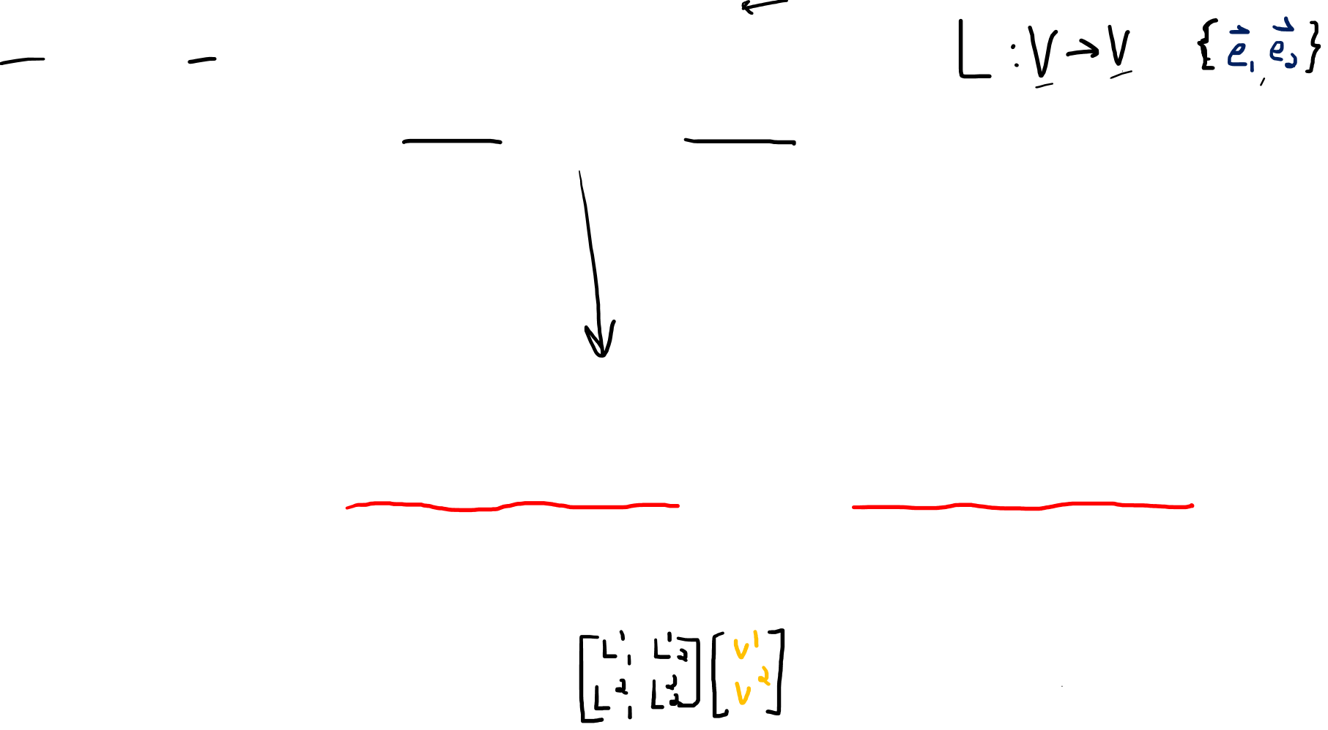
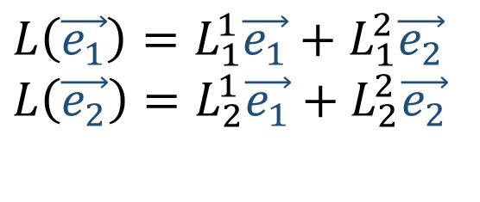
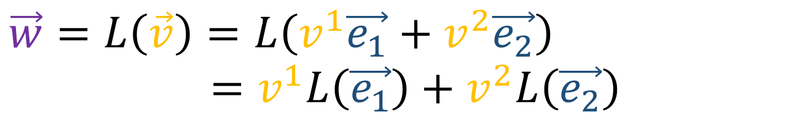


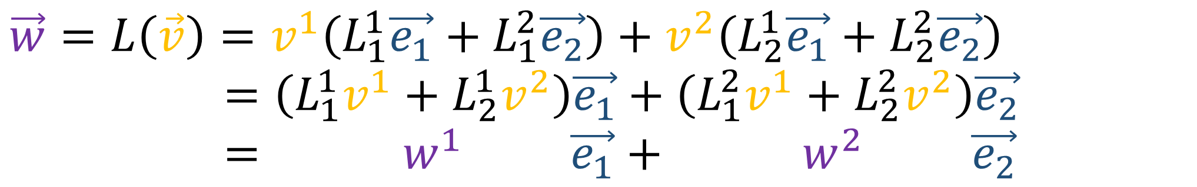
$$\vec{w}=L\left(\vec{v}\right)=L\left(v^{1}\vec{e_{1}}+v^{2}\vec{e_{2}}\right)$$
$$=v^{1}L\left(\vec{e_{1}}\right)+v^{2}L\left(\vec{e_{2}}\right)$$
$$L\left(\vec{e_{1}}\right)=L_{1}^{1}\vec{e_{1}}+L_{1}^{2}\vec{e_{2}}$$
$$L\left(\vec{e_{2}}\right)=L_{2}^{1}\vec{e_{1}}+L_{2}^{2}\vec{e_{2}}$$
$$\vec{w}=L\left(\vec{v}\right)=v^{1}\left(L_{1}^{1}\vec{e_{1}}+L_{1}^{2}\vec{e_{2}}\right)+v^{2}\left(L_{2}^{1}\vec{e_{1}}+L_{2}^{2}\vec{e_{2}}\right)$$
$$=\left(L_{1}^{1}v^{1}+L_{2}^{1}v^{2}\right)\vec{e_{1}}+\left(L_{1}^{2}v^{1}+L_{2}^{2}v^{2}\right)\vec{e_{2}}$$
$$= w^{1} \vec{e_{1}}+ w^{2} \vec{e_{2}}$$
$$w^{1}=L_{1}^{1}v^{1}+L_{2}^{1}v^{2}$$
$$w^{2}=L_{1}^{2}v^{1}+L_{2}^{2}v^{2}$$
Notes:
So just now I related the abstract definition of a linear map back to the geometrical definition.
Now I’d like to show how the abstract definition of a linear map relates back to matrices, or the coordinate definition of linear maps.
So let’s start off by saying that we have a linear map L that acts on a vector input V to produce a vector output W. And expanding the vector into its components, we get this.. and by applying linearity rules we get this.
Now we might ask, how can we express these vectors L-OF-E1, and L-OF-E2, in terms of a basis?
So I’m going to make an assumption here… I’m going to assume that L is a function from V to V… so the input vectors space is the same as the output vectors space….
So since the output vector space V has a basis e1,e2; that means we can write these output vectors as a linear combination of the same old basis vectors e1,e2.
And the coefficients L11, L21, and so forth, these 1s and 2s are just labels. I’ve chose to write one on top and one on the bottom for a reason. I’ll to why I did that later.
But the important thing is these L coefficients help us build the output vectors using these E basis vectors.
Alright, so I can re-write the output vectors as linear combinations of the basis…
And I can switch things around here to group the terms by basis vector…
And now, since I have w written as a linear combination of basis vectors, these coefficients are really just the components of W
So we’ve derived how to transform the V coefficients into the W coefficients, using these formulas here.

Slide 12
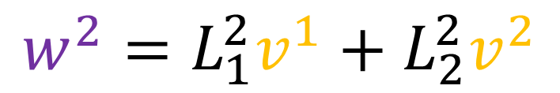
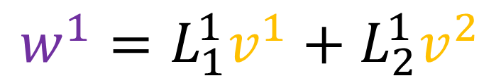

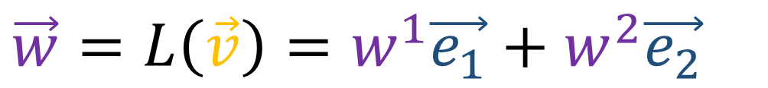

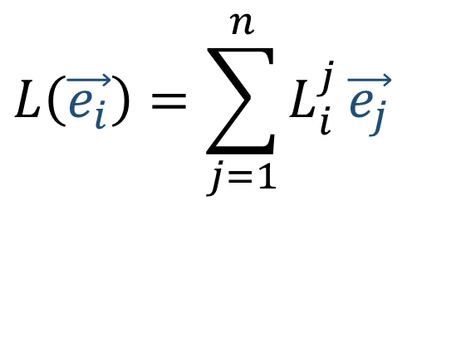
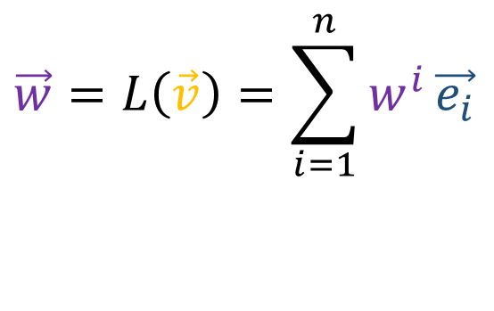

$$\vec{w}=L\left(\vec{v}\right)=w^{1}\vec{e_{1}}+w^{2}\vec{e_{2}}$$
$$\vec{w}=L\left(\vec{v}\right)=\sum_{i=1}^{n}{w^{i}}\vec{e_{i}}$$
$$L\left(\vec{e_{i}}\right)=\sum_{j=1}^{n}{L_{i}^{j}}\vec{e_{j}}$$
$$L\left(\vec{e_{1}}\right)=L_{1}^{1}\vec{e_{1}}+L_{1}^{2}\vec{e_{2}}$$
$$L\left(\vec{e_{2}}\right)=L_{2}^{1}\vec{e_{1}}+L_{2}^{2}\vec{e_{2}}$$
$$w^{i}=\sum_{j=1}^{n}{L_{j}^{i}v^{j}}$$
$$w^{1}=L_{1}^{1}v^{1}+L_{2}^{1}v^{2}$$
$$w^{2}=L_{1}^{2}v^{1}+L_{2}^{2}v^{2}$$
Notes:
Okay, so just to sum all that up, if we have a linear map L than transforms vector V into vector W, like this, where W can be written as a combination of basis vectors.
And we know how L transforms basis vector copies, using these L coefficients,
We can transform the v components into the w components using these formulas here…
And repeating this argument in any dimension...
If we have this linear map L in N dimensions, and we have all the L coefficients from this formula, then we can transform V components into W components using this formula here.
And you might recognize this formula as the multiplication formula for multiplying vectors by matrices. So we actually derived the matrix multiplication formula purely from the abstract linearity properties.
So if you’ve ever wondered why matrix multiplication works the way it does…. It’s just the direct result of the abstract linearity properties of linear maps.

